Slide 1
Shall the Religious Inherit the Earth?
Religious Fertility and the Future of Secular Modernity
Eric Kaufmann
Birkbeck College, University of London/Harvard KSG Belfer Center Fellow
e.kaufmann@bbk.ac.uk

Slide 2
Demography in History
Annales School: including importance of geography, demography
Jack Goldstone – Revolutions
W H McNeill – Plagues and the course of Empire
Jared Diamond: Disease/mortality enables agriculturalists’ conquest
Demography is not destiny: sometimes an independent variable, sometimes mediating, sometimes dependent

Slide 3

Modern education…liberates men from their attachments to tradition and authority. They realize that their horizon is merely a horizon, not solid land but a mirage…That is why modern man is the last man…. (Fukuyama 1992: 306-7)

Slide 4
Social cohesion is a necessity and mankind has never yet succeeded in enforcing social cohesion by merely rational arguments. Every community is exposed to two opposite dangers; ossification through too much discipline and reverence for tradition…or subjection to foreign conquest, through the growth of an individualism…that makes cooperation impossible. (Russell 1946: 22)

Slide 5
So Far, Fukuyama is Right (about the western core)
Liberal democracy and capitalism has weathered:
  ‘Barbarians at the gates’ (technology)
  Economic contradictions and crises (Marx)
  The challenge of socialism
  Social breakdown, crime, decline of saving/work ethic (Bell)
  But is the system demographically sustainable? Could it be conquered from ‘inside’

Slide 6
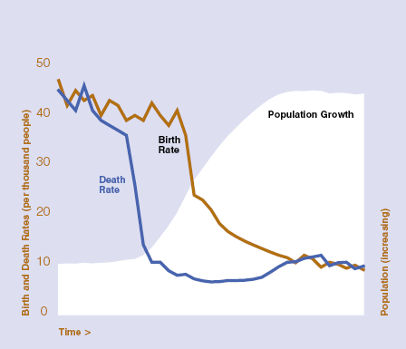
Demographic Transition
Begins in Europe in late 18th c.
Spreads to much of the rest of the world in 20th c
TFR below 2.1 in most of East Asia, Brazil, Kerala, Tunisia, Iran…
World TFR is just 2.55. UN predicts World TFR falling below replacement by 2085

Slide 7


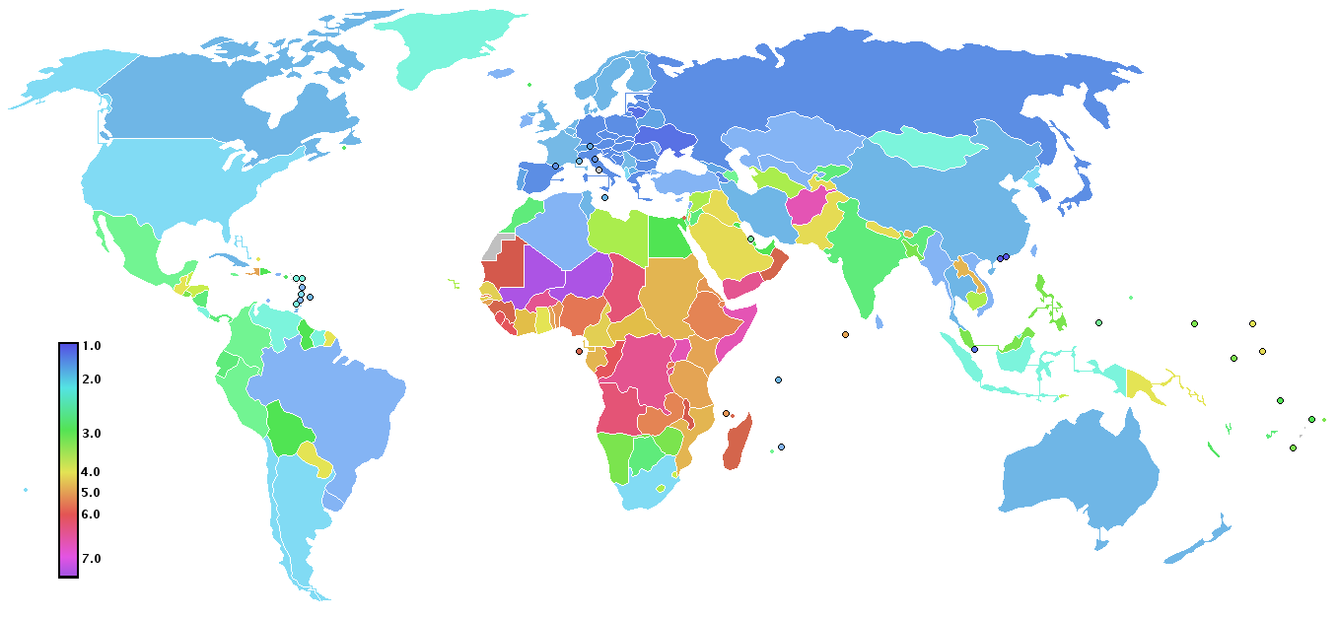
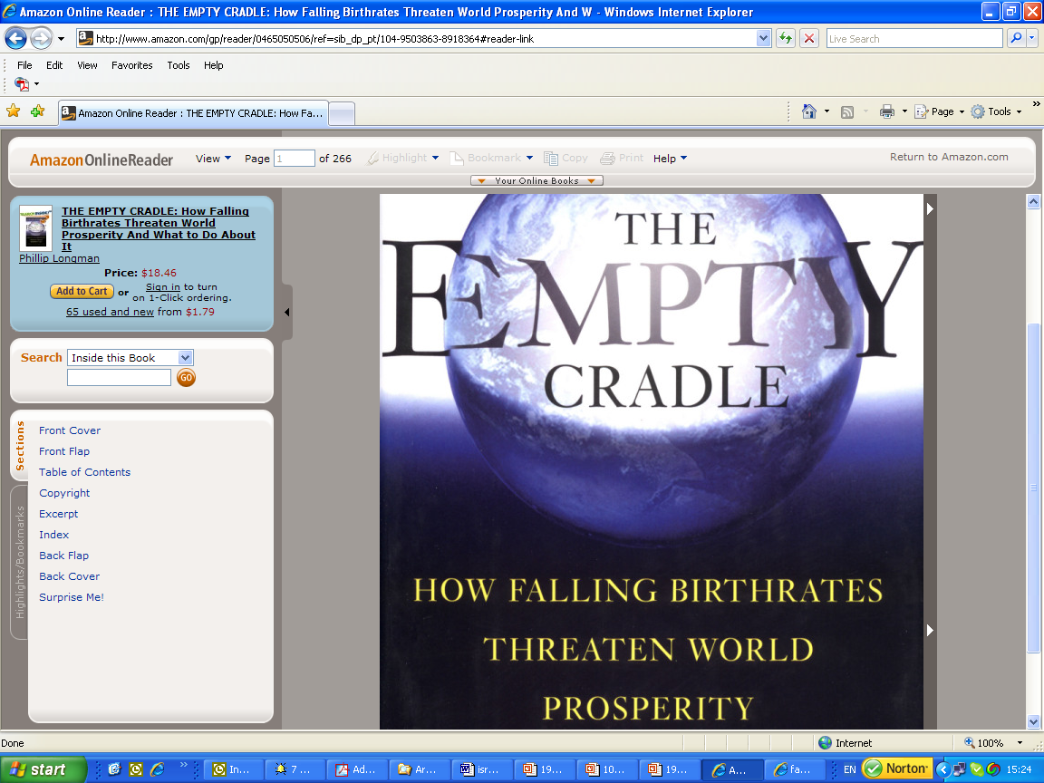
Global Depopulation?: Total Fertility Rates by Country, 2008
Source: CIA World Fact Book 2008

Slide 8
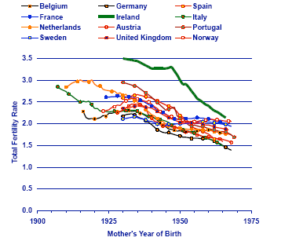
Second Demographic Transition
Below Replacement fertility
No sign of a rebound
**Values, not material constraints, determine fertility (Lesthaeghe & Surkyn 1988; van de Kaa 1987)

Slide 9
World's Oldest Countries, 2000 and 2050
in 2000 in 2050
Country
15-59
60+
15-59
60+
Italy
61.7
24.1
46.2
42.3
Greece
61.5
23.4
46.2
40.7
Germany
61.2
23.2
49.5
38.1
Japan
62.1
23.2
45.2
42.3
Sweden
59.4
22.4
48.3
37.7
Belgium
60.6
22.1
50.3
35.5
Spain
63.5
21.8
44.5
44.1
Bulgaria
62.6
21.7
47.6
38.6
Switzerland
62.1
21.3
48.6
38.9
Latvia
61.7
20.9
47.5
37.5
Portugal
62.5
20.8
49.9
35.7
Austria
62.6
20.7
47.4
41.0
United Kingdom
60.4
20.6
51.1
34.0
Ukraine
61.6
20.5
49.0
38.1
France
60.7
20.5
51.3
32.7
Estonia
62.1
20.2
48.5
35.9
Croatia
61.8
20.2
53.0
30.8
Denmark
61.8
20.0
53.0
31.8
Finland
62.0
19.9
50.6
34.4
Hungary
63.3
19.7
49.4
36.2
Norway
60.7
19.6
51.7
32.3
Luxembourg
62.0
19.4
57.1
25.2
Slovenia
65.0
19.2
45.1
42.4
Belarus
62.4
18.9
49.6
35.8
Romania
62.9
18.8
50.0
34.2
Source: Goldstone 2007

Slide 10
Source: Goldstone 2007

Slide 11

Anabaptist Religious Isolates
Hutterites: 400 in 1880; 50,000 today.
Amish: 5000 in 1900; 230,000 today. Doubling time: 20-25 years. (i.e 4-5 million by 2100)
Fertility has come down somewhat, but remains high: 4.7-6.2 family size
Retention rate has increased from 70 pc among those born pre-1945 to over 90 pc for 1966-75 cohort

Slide 12
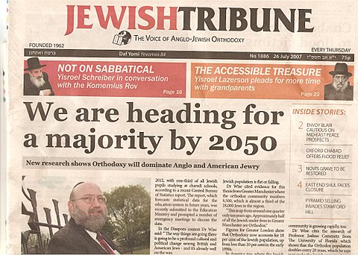

Slide 13
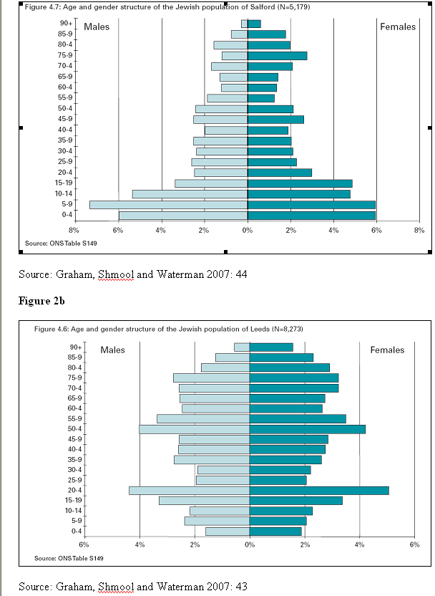
UK: A Tale of Two Cities: Salford v Leeds
US:
  American Jews have TFR of 1.43. In 2000-6 alone, Haredim increase from 7.2 to 9.4 pc of total.
  Kiryas Joel, in Orange Co., New York, nearly triples in population to 18000 between 1990 and 2006

Slide 14
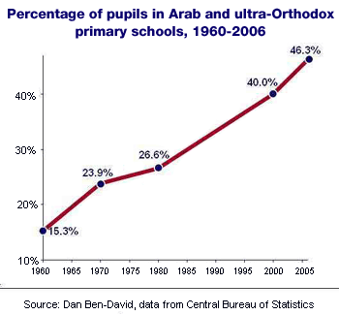
Source: ‘The Moment of Truth’, Ha’aretz, 8 February 2007

Slide 15
Israel: Ultra-Orthodox Jewish Growth
TFR of 6.49 in 1980-82 increasing to 7.61 in 1990-96; Other Israeli Jews decline 2.61 to 2.27
Proportion set to more than double, to 17% by 2020
No indication of major outflows
Majority of Israeli Jews after 2050?

Slide 16
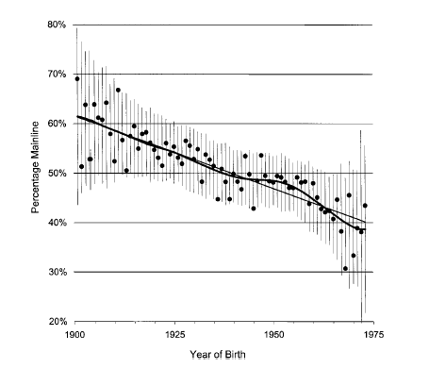
USA: 20th c Rise of Evangelical Protestants
Source: Hout at al. 2001

Slide 17
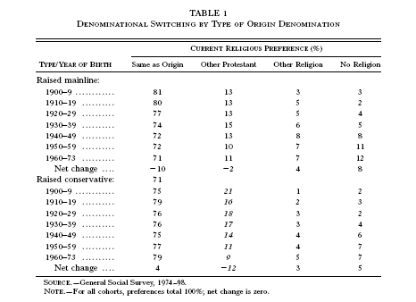
Religious Switching No Longer Favours Liberal Denominations

Slide 18
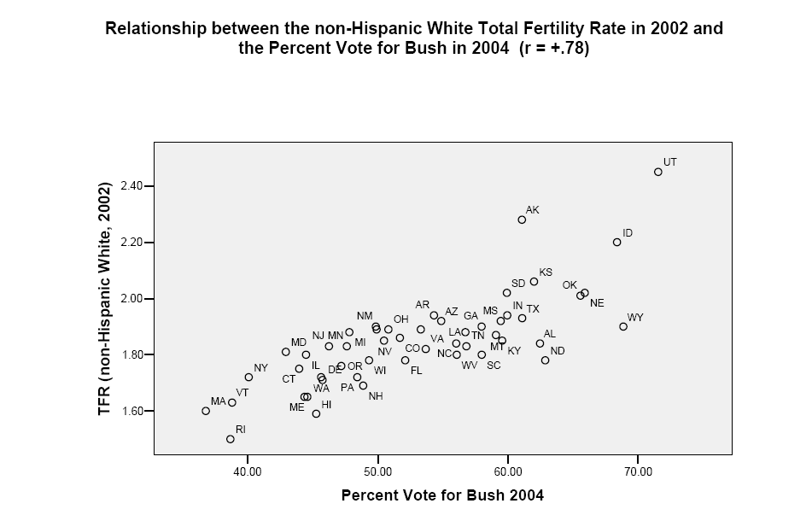
Source: Lesthaeghe and Neidert 2005

Slide 19
Ethnic/National Differences Fade, but Intra-Religious Gap Widens
Catholic-Protestant in US; now Muslim-Christian in Europe
But religious intensity linked to higher fertility
Europe: No clear data by theology, but regular attenders have higher fertility (Adsera 2004; Regnier-Loilier 2008, etc)
Conservative Muslim and Christian immigration to Europe
Fertility Gap, Women Aged 40-60 (Children Ever Born) in GSS 1972-2006
 | Biblical Literalist | Homosexuality | Abortion
1972-85 | 1.15 | 1.11 | 1.22
1986-96 | 1.21 | 1.16 | 1.28
1997-2006 | 1.25 | 1.21 | 1.38

Slide 20

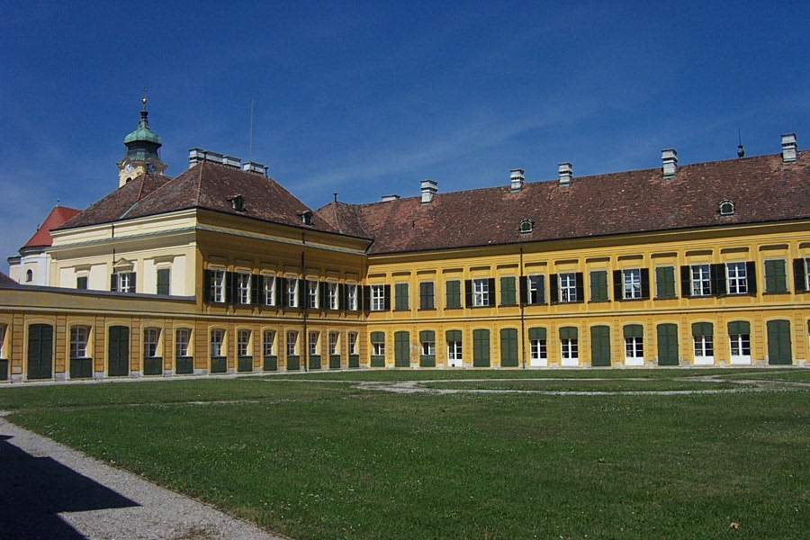
IIASA, near Vienna

Slide 21
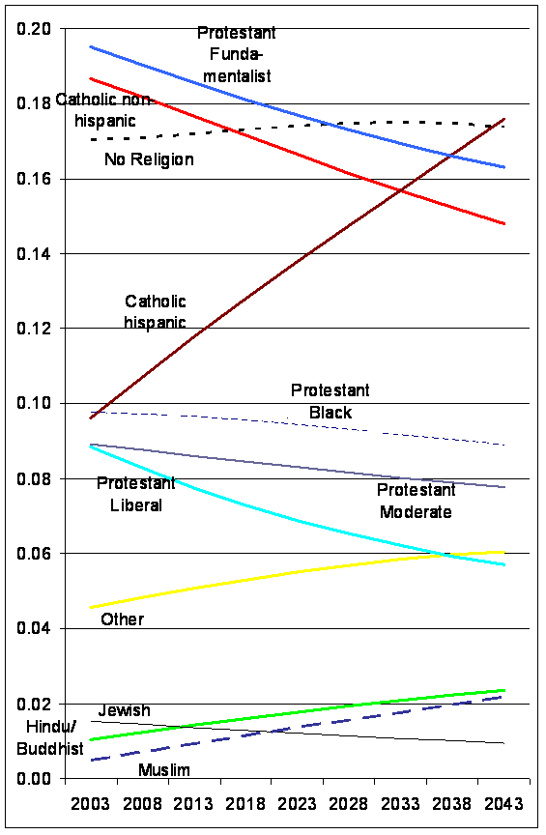
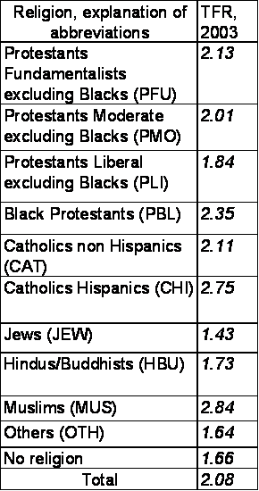
Similar Dynamics in USA

Slide 22

Austria: Projected Proportion Declaring
‘No Religion’
Assuming:
High secularization trend
Constant secularization trend
Low secularization trend
 | Austria, TFR 2001
Roman Catholics | 1.32
Protestants | 1.21
Muslims | 2.34
Others | 1.44
Without | 0.86
Total | 1.33

Slide 23
Islamism and Fertility
‘Our country has a lot of capacity. It has the capacity for many children to grow in it…Westerners have got problems. Because their population growth is negative, they are worried and fear that if our population increases, we will triumph over them.’ – Mahmoud Ahmadinedjad, 2006
‘You people are supporting…the enemies of Islam and Muslims...Personnel were trained to distribute family planning pills. The aim of this project is to persuade the young girls to commit adultery’ – Taliban Council note to murdered family planning clinic employee, Kandahar, 2008

Slide 24
Is Islam Different?
Yet Islamic governments (i.e. Pakistan, Iran) promote family planning. Fatwas obtained.
Most Muslim countries more conformist in religious terms (ie fewer seculars, less switching)
Second Demographic Transition More Muted
Puritanical Islam associated with cities, vs. rural heterodoxy/folk religion

Slide 25
No Evidence of Compositional Effects in Muslim Countries
Source: Turkish National Statistics 2007, and own calculations.

Slide 26
Source: WVS 1999-2000. N = 2796 respondents in towns under 10,000 and 1561 respondents in cities over 100,000. Asked in Algeria, Bangladesh, Indonesia, Jordan, Pakistan, Nigeria and Egypt.

Slide 27
Conclusion: Demographic Trends
Conservative religion growing fastest in Israel/diaspora (change within a decade), major change 2010-2050
In the US and Europe, the change will take place slowly, over generations
Muslim world: more like US/Europe. Conservative advantage should grow with modernization
Driven by demography and retention

Slide 28
Did it Happen Before?:
The Rise of Christianity
40 converts in 30 A.D. to over 6 million adherents by 300 A.D. (Stark 1997)
Cared for sick during regular plagues, lowering mortality
Encouraged pro-family ethos (as opposed to pagans’ macho ethos), attracting female converts and raising fertility rate
40 percent growth per decade for 10 generations, same as Mormons in USA in past century
Reached 'tipping point' and then became established in 312

Slide 29
So what if they replace us?
Maybe a strongly conservative society can be democratic and capitalist, but unlikely to be liberal and post-historical
Difficult to hygienically separate trends in private belief from hegemony in public politics (i.e. US: public religion, abortion, homosexuality, alcohol)
Security Threat? Depends on quietist vs temporal mode.

Slide 30
Security Issues
Conservatives are often quietist or pragmatic: i.e. Haredim, Mormons, Pan-Islamists. But a militant fringe, ie Yigal Amir and Hesder students; US anti-abortionists; Islamic jihadis.
Islam seems most politicized, but also least demographically polarized; Judaism has least demographic radicalism
All religious militants are fundamentalist, though not all fundamentalists are militant.
Increase in religious violence, but not necessarily an increase in total violence (Toft 2007)

Slide 31
Project Website
http://www.sneps.net/RD/religdem.html

