Slide 1
Demographic Change and Conflict in Northern Ireland: Reconciling Qualitative and Quantitative Evidence
Eric Kaufmann
Department of Politics
Birkbeck College
e.kaufmann@bbk.ac.uk

Slide 2
Unionist Pressure and Catholic Emigration
‘Protesting strongly against the action of our Ulster and Protestant government in permitting the appointment of a Roman Catholic to be in charge of the allocation of houses built in county Tyrone, Fermanagh, South Derry and a large part of the county of Armagh [areas with an even ethnic balance]....We feel that all our endeavours to increase the Unionist majority have been brought to nought by the action of this unacceptable person who has for instance allocated over 90 percent of houses in Keady [a South Armagh town with a Catholic majority of 79 percent in 1971] to RC Republicans. We demand their immediate withdrawal from their position of responsibility.' – N. Armagh Unionist party branch to Glengall St. headquarters, 1950 (Patterson & Kaufmann 2007: 50) Also a reference from Fermanagh Orange county minute book of 1951 to land being bought by minister of agriculture and sold to Catholics 'in areas where [we] could ill afford to lose property to the other side' because our ‘majority was very slender’

Slide 3
Catholic Emigration
“Though they formed just 35 percent of Northern Ireland's population, Catholics made up 60 percent of its emigrants. The disproportionate losses among Catholics in the 15-40 age cohort reversed the gains that would otherwise have accrued to the Catholic community. Indeed, the 20-24 age cohort was 25 percent smaller than the 15-19 cohort in 1971.” – Leuprecht 2012

Slide 5
Demography and Ethnic Conflict: Northern Ireland
"The basic fear of Protestants in Northern Ireland is that they will be outbred by the Roman Catholics. It is as simple as that." - Terence O’ Neill, Unionist PM of Northern Ireland after resigning, 1969

Slide 7
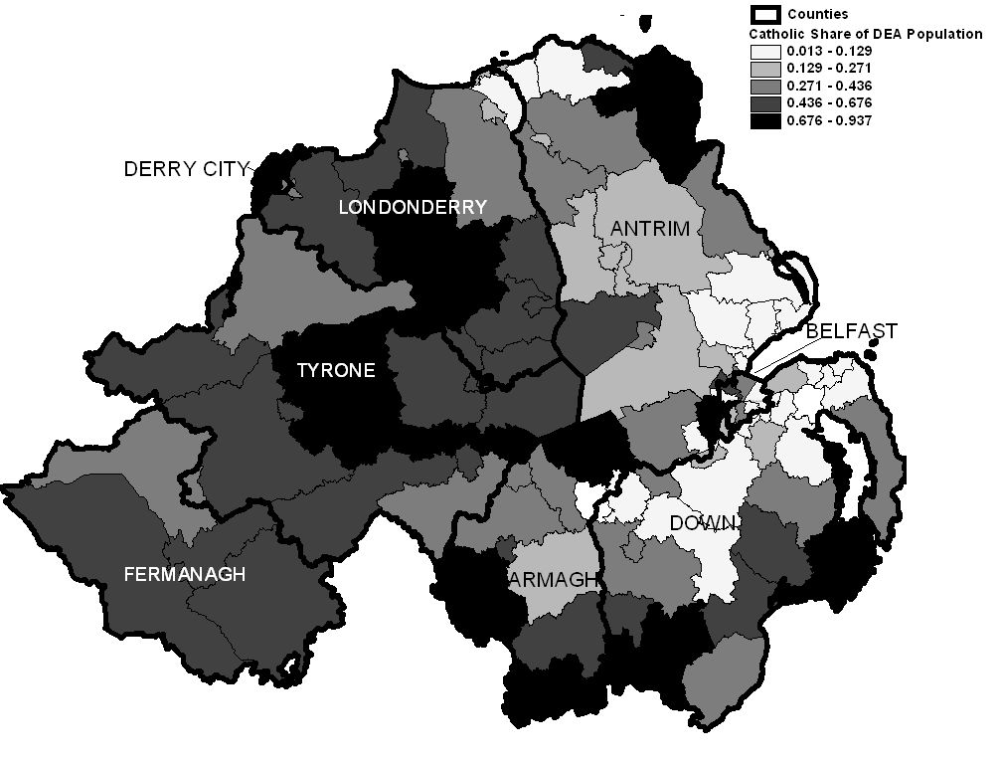

Slide 8
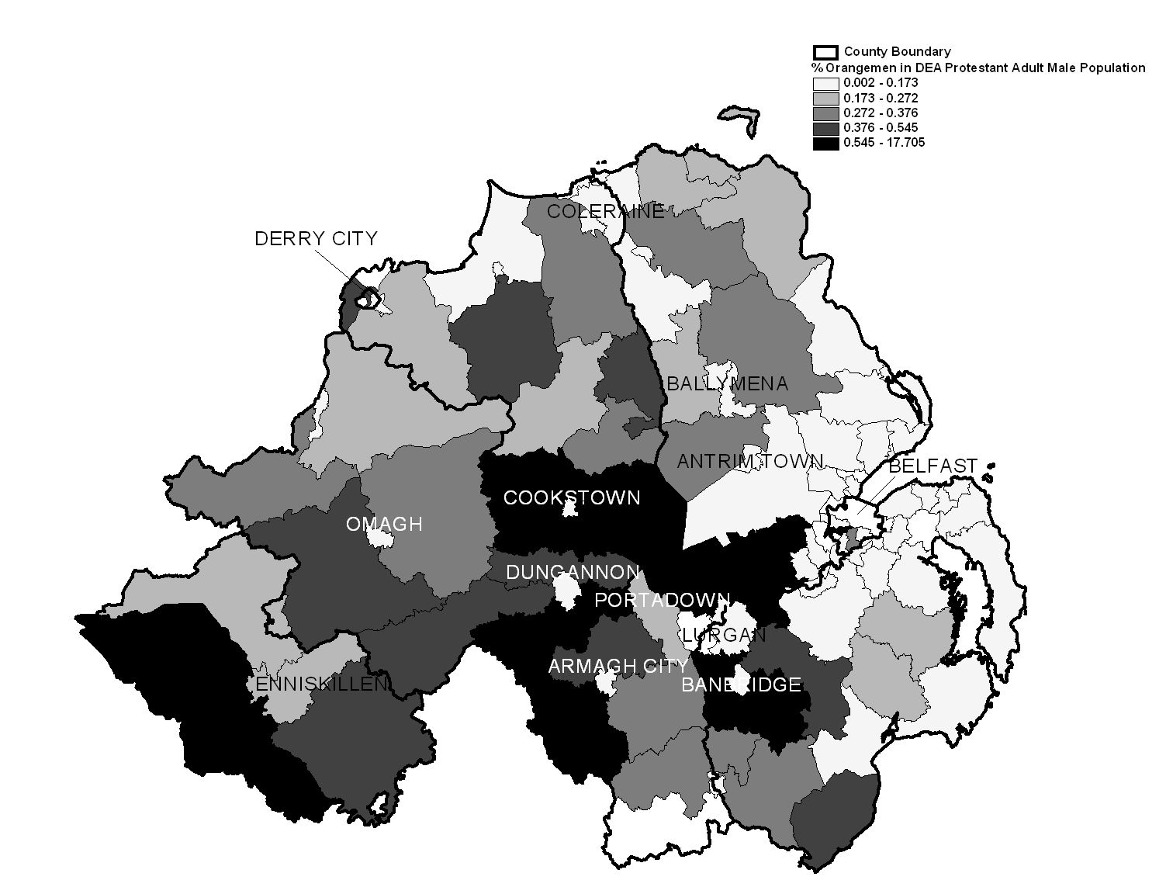

Slide 9
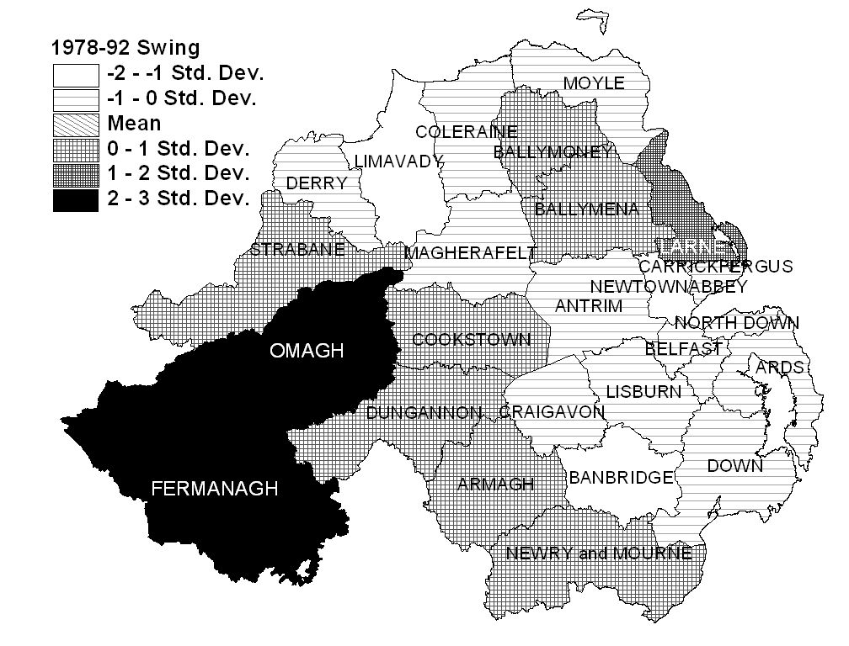

Slide 10
Moderate Orangemen West of Bann
‘Many of the [Tyrone] towns and villages now had Protestant minorities and it was felt that we would only be adding to our own local future problems if we were to protest in many of the Districts...the recent atrocity in Omagh [bombing of centre] has caused so much grief within all sections of the community that any immediate action over these next weeks and months would be seen as very insensitive'.- Co. Tyrone Orange Lodge reply to GOLI Parades Strategy Committee, 26/08/98

Slide 11
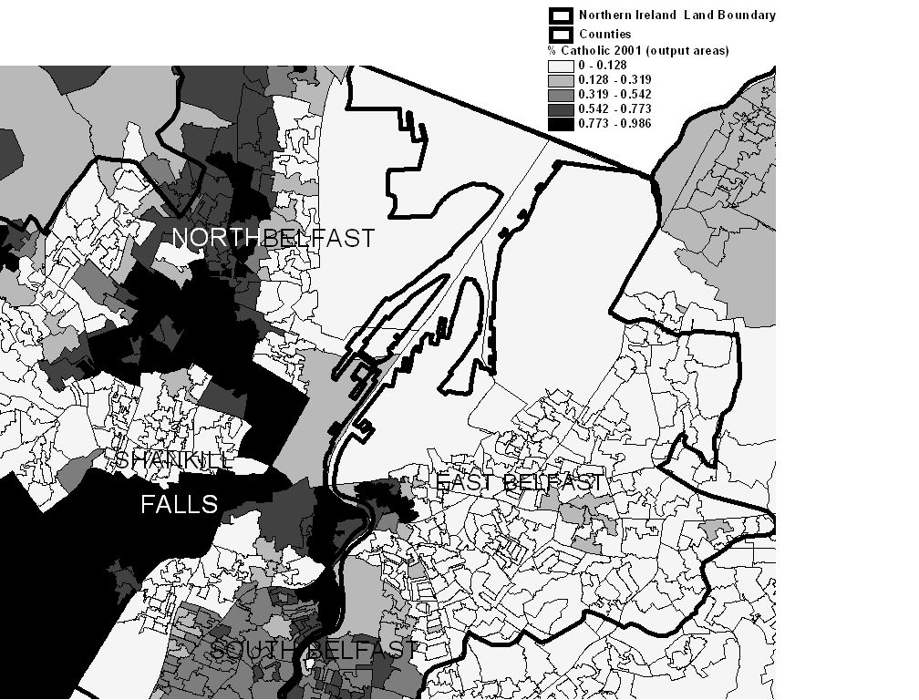

Slide 13
If you look at Glenbryn it is really a very small community surrounded by a much larger republican one. People there are hemmed in and they see Ardoyne expanding constantly. Continual talk of the rising nationalist population makes people feel that even more. To Protestants in Glenbryn it feels that if they give away any more ground they will be wiped out as a community. People there are always on the defensive and feel their plight is ignored. The [Holy Cross] protest was a disaster in terms of putting their cause forward but it was a genuine expression of their anger and frustration and fear over what is happening in that part of North Belfast.

Slide 14
People are apprehensive about the future, they don't know what it is going to bring and often that fear can manifest itself in violence. Before the cease-fires that anger expressed itself in shootings and bombings, and even if people didn't go out and join organisations like the UVF or the UDA they felt that their interests were being looked after by them. Since 1994 people haven't had that and I believe that is part of the reason for the rise in sectarianism at the interfaces. No-one is going out and doing the shootings or the bombings so people from interface areas are more likely to vent their anger on each other.

Slide 15
Catholic Demography and Peace?
“It was possible to persuade The Army that there was an alternative path to a United Ireland than through fighting. If Catholics had still been at 33% of the population it would have been hard to make the case to them to lay down their weapons.” - Paul Morland, interview with Mitchel McLaughlin, 21st February 2012
“Irish Unification will happen… The Good Friday Agreement provides a legislative, peaceful and democratic route to achieve this. And the economic and demographic dynamics in Ireland make Irish reunification a realistic objective within a reasonable timescale.” Sinn Fein Breaking News 25th June 2008 http://www.sinnfein.ie/contents/13065

Slide 16
Conclusion
Demography matters for violence, but often not directly, viz:
I.e. Ethno-demographic variation over place → Protestant mobilisation in Border counties → Unionist resistance to Catholic civil rights → some Catholic support for the IRA → IRA violence.
Catholic demographic growth → Shifting calculation of ballot box v armalite → IRA demilitarise
Catholic growth → Public Housing Decisions → Territorial pressure on interfaces → Unionist violence

Slide 17
Shameless plug

